Slide 1
Generative Adversarial Networks (GANs)

Slide 2
Generative Models
Statistical models of data distributions (typically high-dimensional, complicated probability distributions)
Sample generation
Density estimation
…
Training Data
Model generated samples

Slide 3
GANs - Overview
A framework for estimating generative models via an adversarial process
Simultaneously train two models
A generator G that generate fake samples, tries to fool the discriminator
A discriminator D that tries to distinguish between real and fake samples

Slide 4
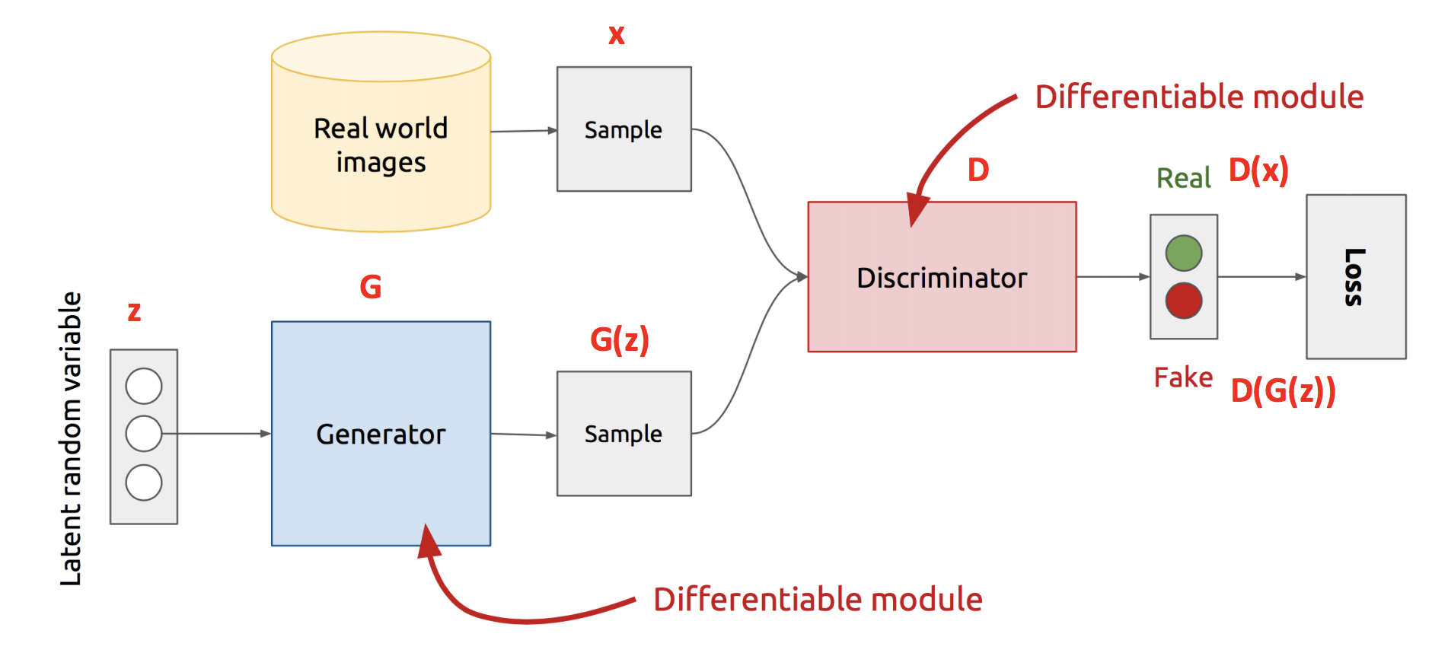
GANs - Architecture
z is some random noise (Gaussian/Uniform)
z can be thought as the latent representation of the image

Slide 5
Training Procedure
Update D and G alternatively
Run k steps of D for every step of G
Each step D optimize the weights
A minibatch of training data
A minibatch of generated samples
Each step G optimize the weights
A minibatch of generated samples

Slide 6
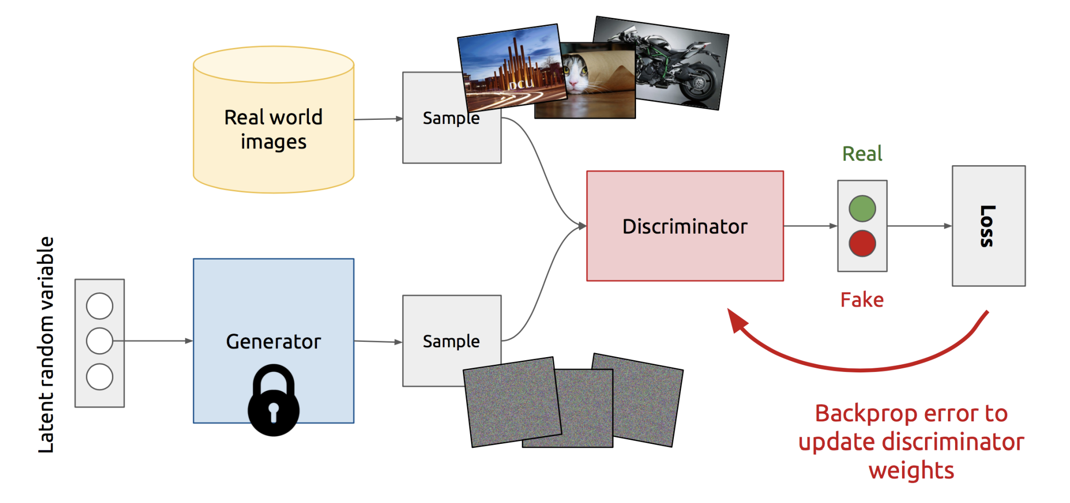
Training Discriminator

Slide 7
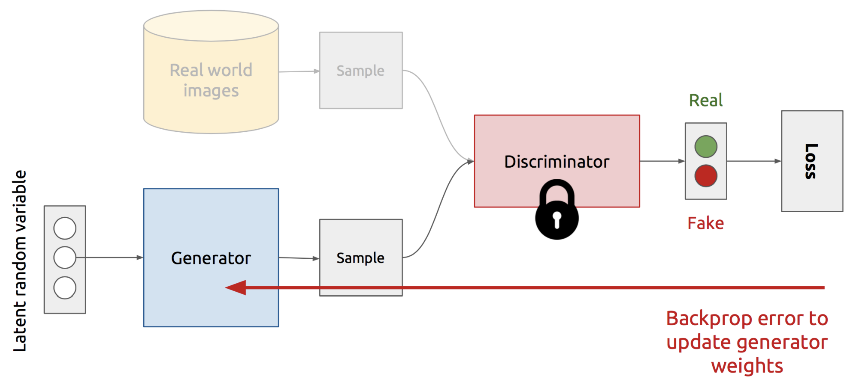
Training Generator

Slide 8
Loss and Divergence
A minimax game
The Discriminator is trying to maximize its reward
The Generator is trying to minimize Discriminator’s reward
D loss =
G loss =

Slide 9
Loss and Divergence
This is related to Jensen-Shannon divergence between
real and fake samples. How?

Slide 10
Loss and Divergence
For a fixed G, the optimal discriminator D is

Slide 11
Loss and Divergence
KL Divergence:
JS Divergence:

Slide 12
Loss and Divergence

Slide 13
Not Just JSD
f-gan
Wasserstein GAN

Slide 14
f-GAN
f-divergence
Examples
KL:
JS:
etc.

Slide 15
f-GAN
Objective function:

Slide 16
Wasserstein GAN
Problem of f-GAN (including the vanilla GAN)
Gradient vanish if two distributions are not overlapped with each other
Wasserstein GAN is based earth mover’s distance (EMD), which provides better gradients
JSD = ln(2)
JSD = ln(2)
JSD = ln(2)
EMD = 2
EMD = 0.5
EMD = 0.1

Slide 17
Wasserstein GAN
Objective function:
Enforce a Lipschitz constraint
weight clipping

Slide 18
More Than Simply Generating Sample
Conditional GAN
InfoGAN

Slide 19
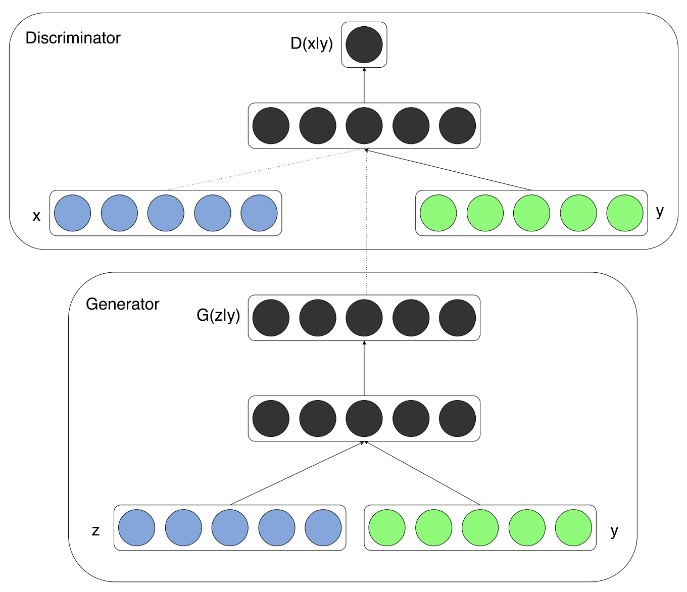
Conditional GAN

Slide 20
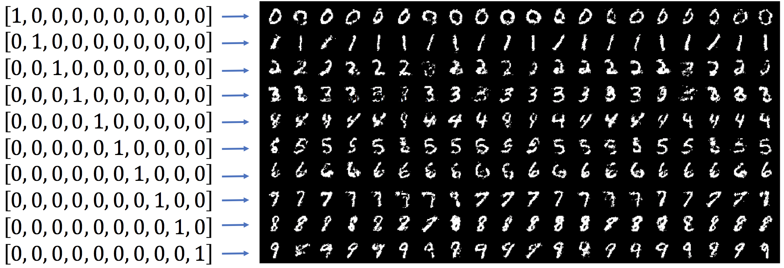
Conditional GAN - MNIST
y

Slide 21
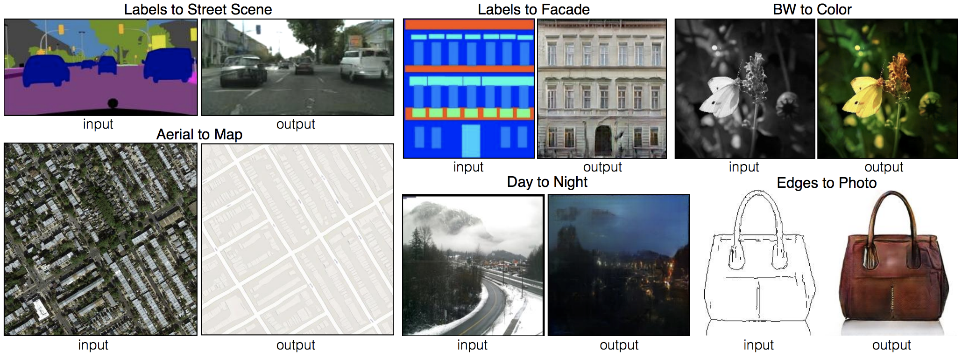
Conditional GAN – Applications

Slide 22
InfoGAN
GAN: correspondence between z and x is not interpretable and uncontrollable
CGAN: The label y are provided in the training data
InfoGAN: Learn disentangled representations in an unsupervised mannar
writing styles from digit shapes on the MNIST dataset
pose from lighting of 3D rendered images

Slide 23
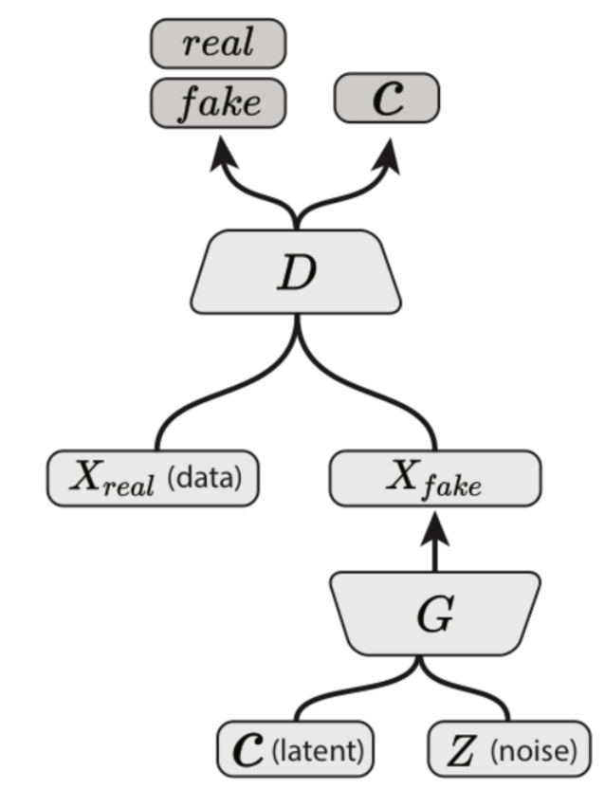
InfoGAN
Decompose the input noise vector into two parts
z, random noise
c, the latent code that represents the most salient and most meaningful sources of variation in the data
Maximize the mutual information between c and G(z, c)
$$≥$$
Mutual information between X and Y:
H(X), entropy of X

Slide 24
InfoGAN – Detailed Proof
Variational Information Maximization

Slide 25
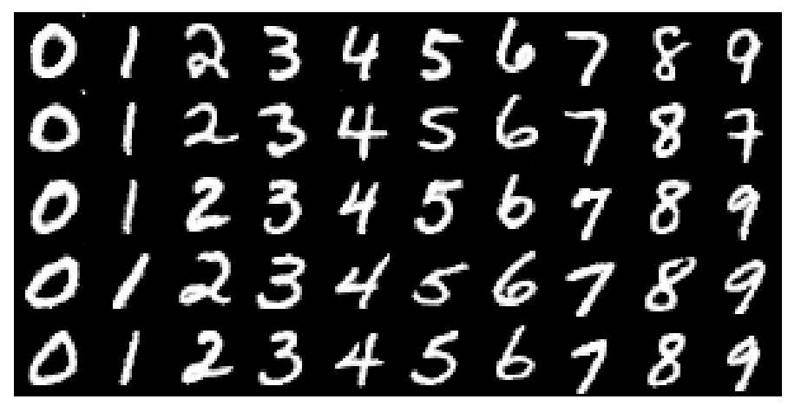
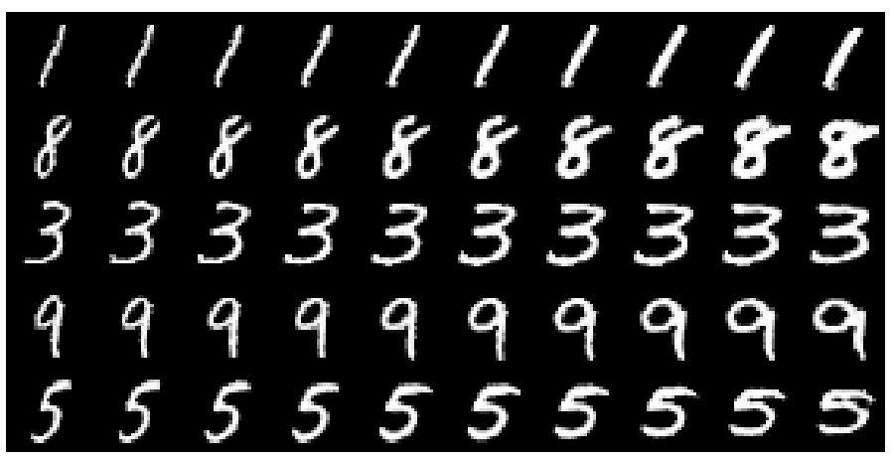
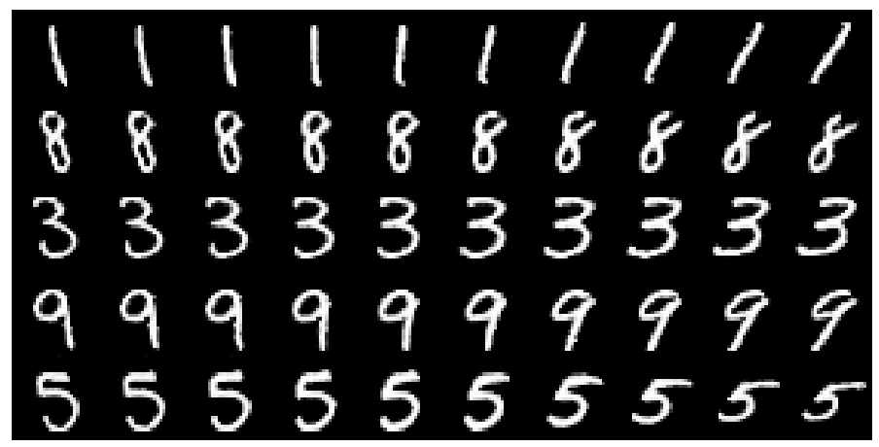
InfoGAN - Examples
c₁
c₂
c₃
…
z
Varying c₁
Varying c₃
Varying c₂

Slide 26
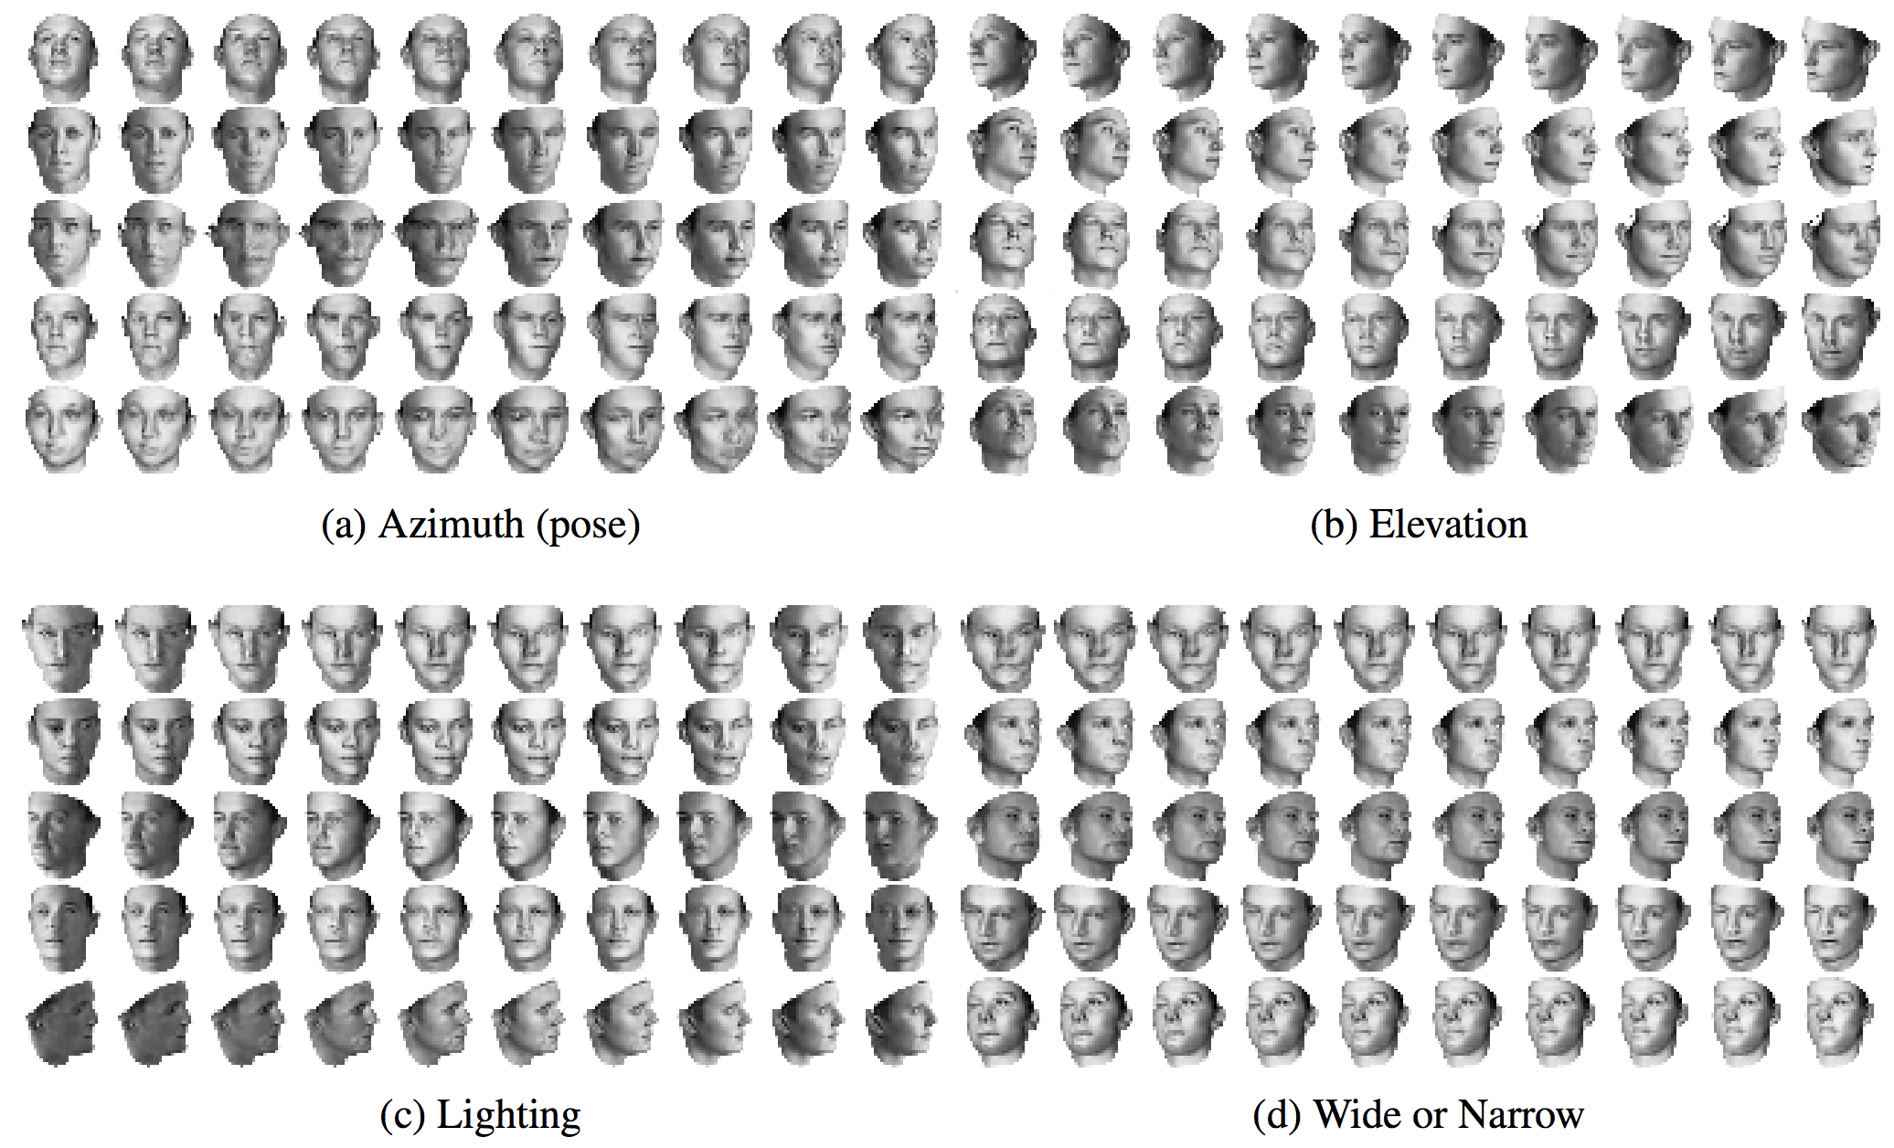
InfoGAN - Examples

Slide 27
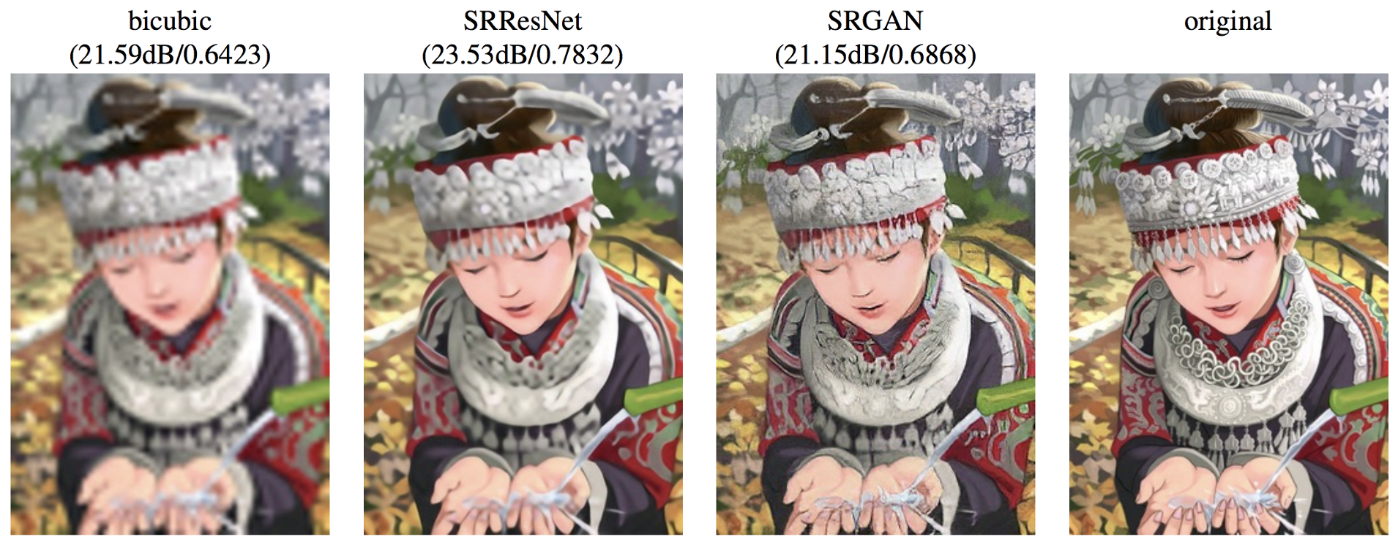
Beyond Learning Distributions
When solving a regression problem
Using a discriminator instead of a fixed loss function
Image Super Resolution
GAN Volume Rendering

Slide 28
Thanks

